Slide 1

Slide 1
Who is doing what?
By Aayush Mandhayan
Sagar Jain
(GROUP 41)

Slide 2

Slide 2
Brief introduction to the topic
As we all know, one of the biggest evolution of 21st Century is Social Media.
It has gradually infiltrated our daily lifestyles. Be it Facebook, Twitter, Instagram, etc. People will find their friends, family or a complete strangers to connect and share their experiences with.
This has given people the freedom, to express themselves to much wider audience than ever before in the history of Mankind.
Social Media has bestowed us with a platform where people from different cultural backgrounds can socialize and be the part of Globally Acknowledged Citizen Movement.
Who's doing what and what should we do to be the part of the trend is the question which is chasing us for centuries?
2

Slide 3
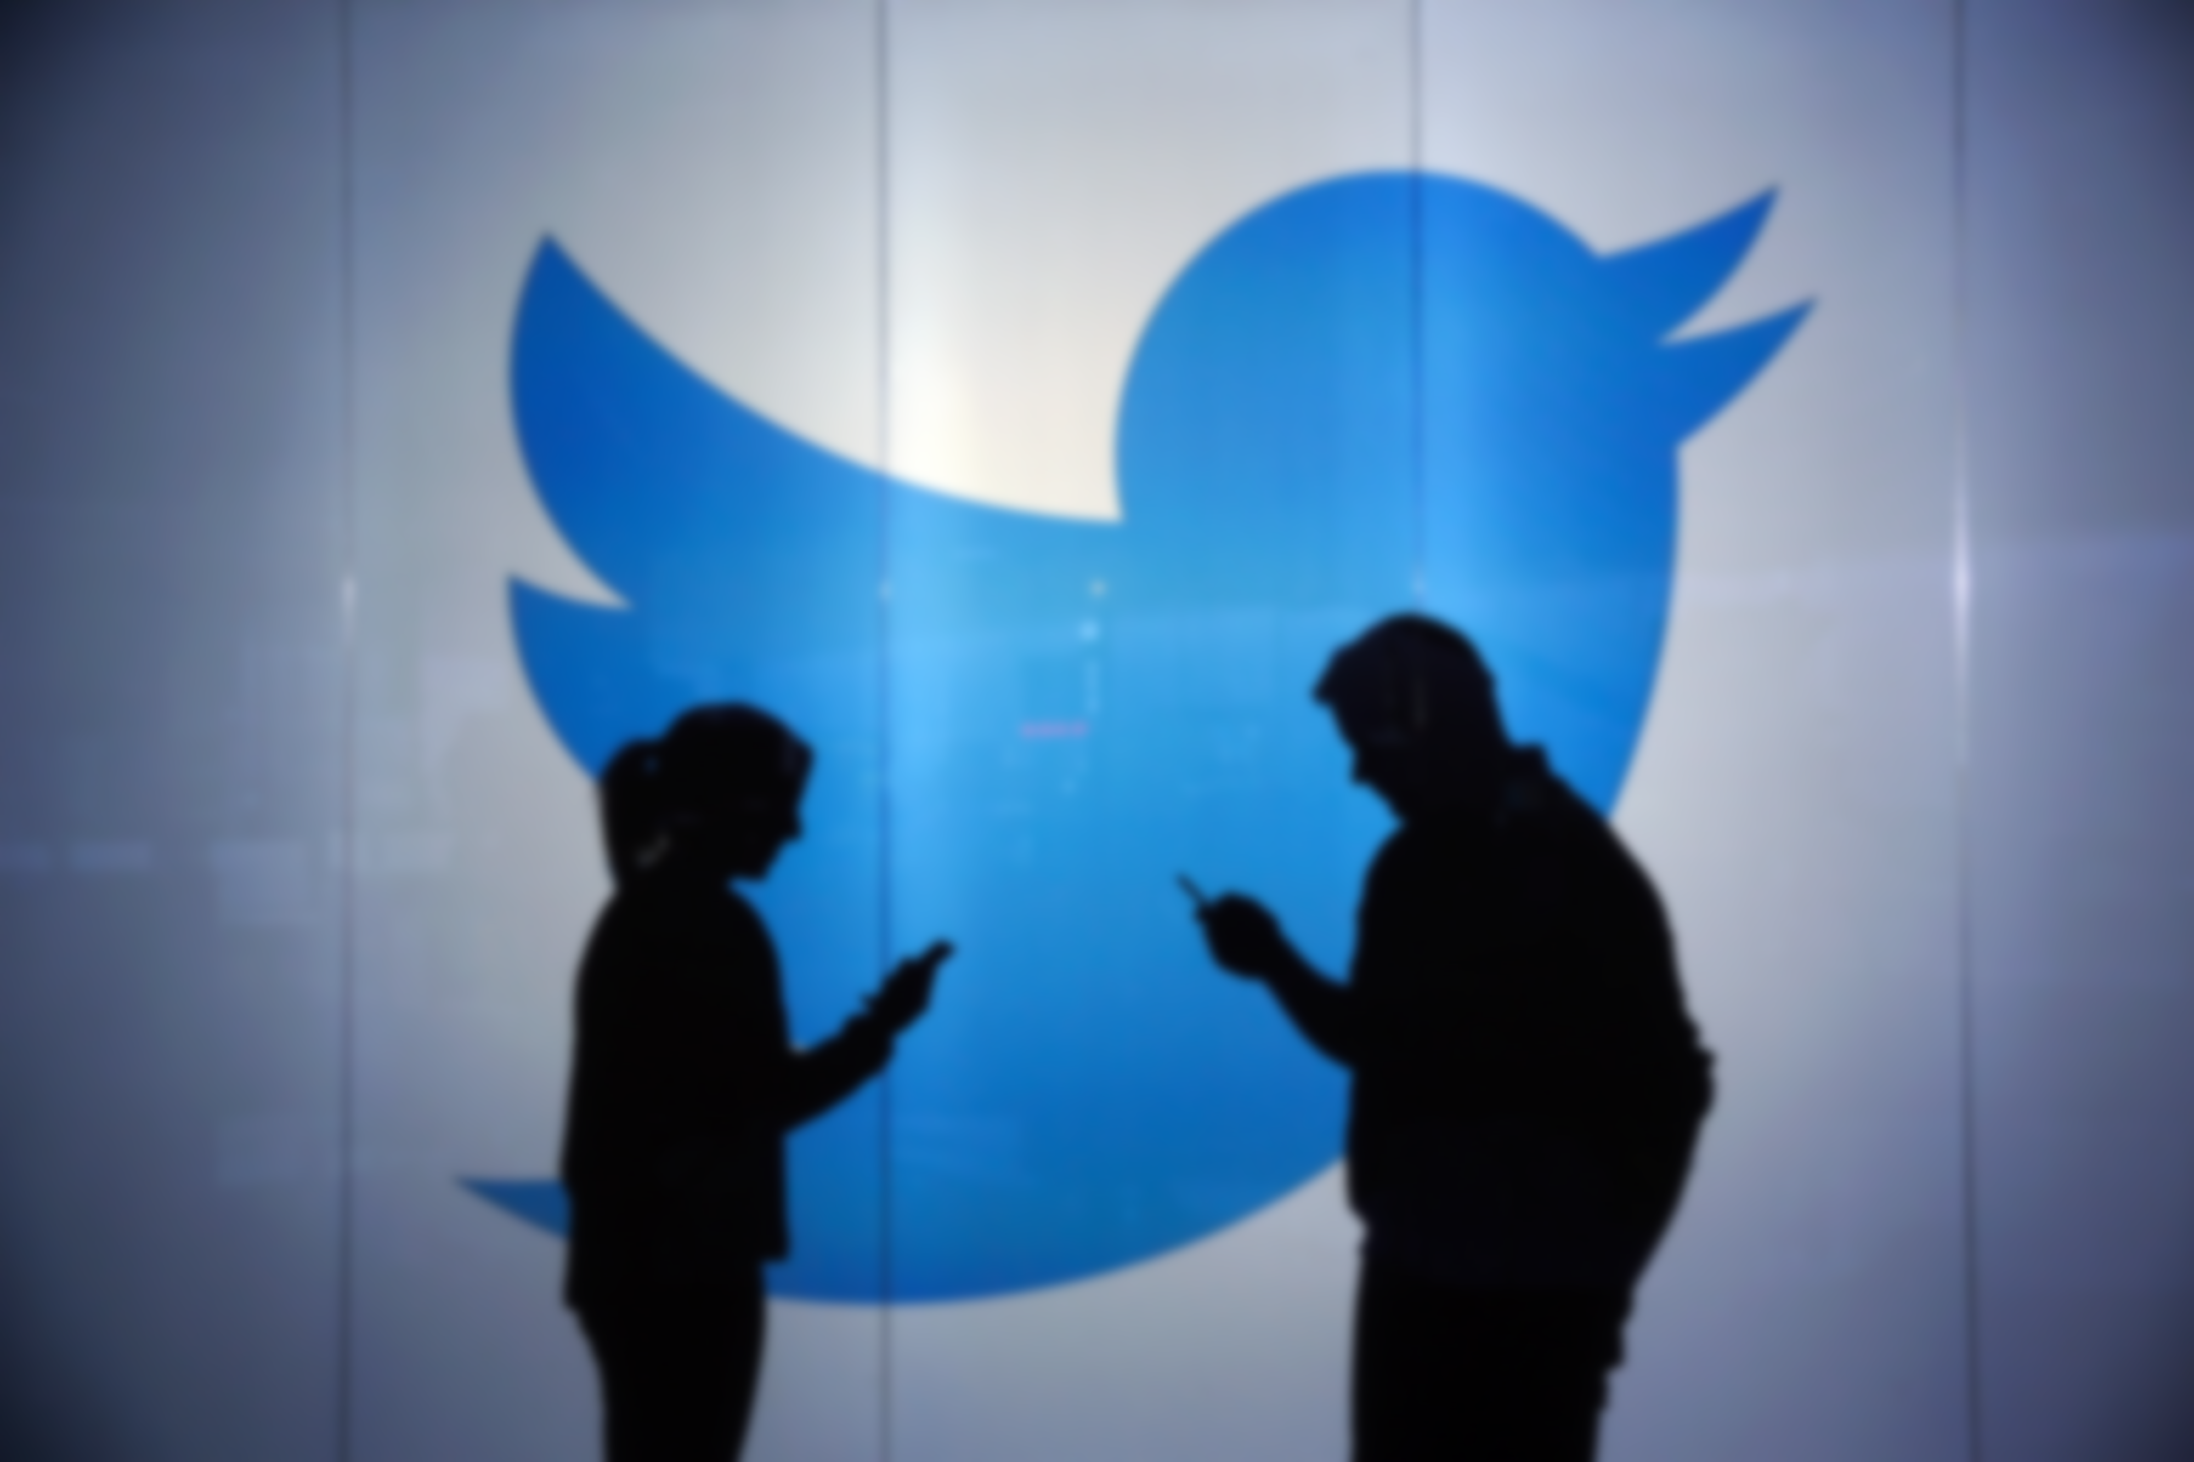




Slide 3
Twitter data : software vulnerabilities
Data given by DARPA
Consisting of ~70,000 Tweets
Tweets over the span of 541 days.
Data format: JSON object.
Data given by DARPA
Consisting of ~70,000 Tweets
Tweets over the span of 541 days.
Data format: Json object.
Your logo
3

Slide 4


Common Vulnerabilities and Exposures (CVE)
Open source components are now present in 96% of commercial applications. The average application includes 147 different open source components - and 67% of the applications surveyed used components with known vulnerabilities. Modern software practice is absolutely dependent on open source libraries and components.

Slide 5

Slide 4
Why this specific data?
In order to continue to produce high quality software, it is critical to know how awareness of vulnerabilities and patches spread and are prioritized among the community of developers, and be able to understand the factors which affect how security practices can become normalized into ordinary developer habits.
Your logo
5

Slide 6

Slide 5
Our GOAL!!
To predict amount of tweets on a particular topic on subsequent day.
6

Slide 7
Slide 9
Methodology
Time series prediction.
Extracting twitter topics using hashtags.
Create time series for tweet cluster
Create hashtag clusters.
EXTRACTION
Create Doc2Vec for hashtags
Cluster tweets based on hashtag cluster
7

Slide 8

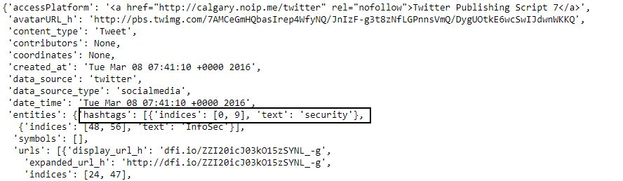
Slide 6
HASHTAGS
8

Slide 9

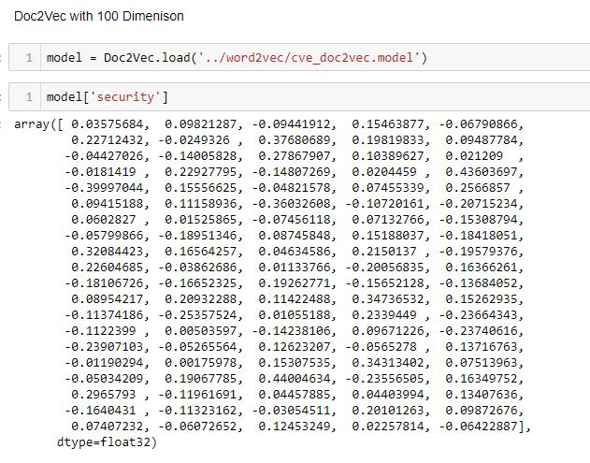
Slide 8
Creating Doc2vec
9

Slide 10


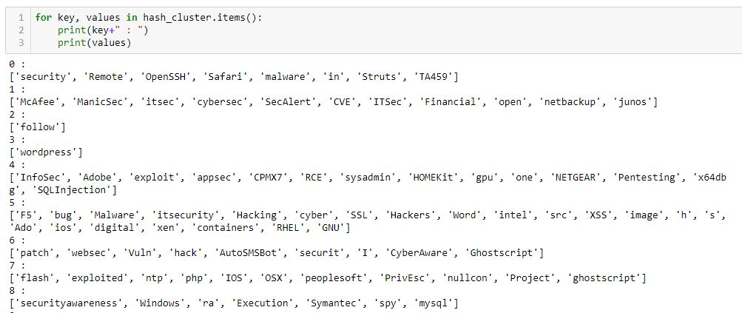
Slide 7
Cluster 1
Cluster 2
Cluster 3

Slide 11

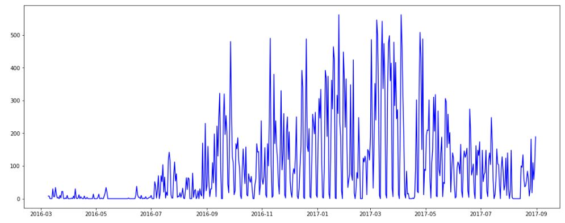
Slide 10
Creating time series
Based on the Hashtag cluster, we cluster the tweets accordingly.
CVE twitter Data is spread over a period of 541 days.
#tweets
#time
11

Slide 12
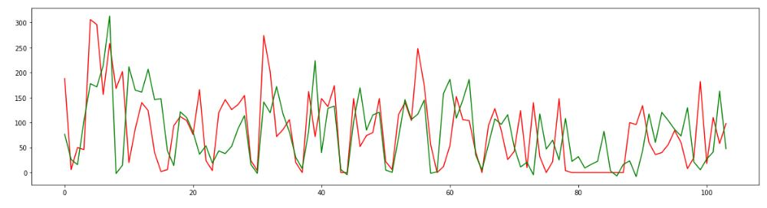
Slide 10
Time series prediction
CVE twitter test Data for cluster 15 is spread over a period of 100 days.
INFERENCE :
Total Mean Squared Error: 5935
Average error per day: 57.06730769230769
#tweets
#timeperiod 100 days
Cluster 15 : ['cybersecurity', 'java', 'Vulnerability', 'sec', 'spartan', 'MeetingSe', 'iot', 'gstreamer', 'Hacked', 'virusscan', 'WannaCry']
12

Slide 13

Slide 11
THANK YOU

